Slide 1



Slide 2
Engaging Teachers and Staff with
Online Learning Programs

Slide 3


Today we’ll cover:
High Quality Professional Development
District Leader Perspectives
Examples: How to Build Online Learning Programs

Slide 4


Presenters
Susan Walters
Solutions Consultant
Frontline Education
Mitch Welch
Solutions Consultant
Frontline Education

Slide 5


District Leader
FEATURING
April Strong
Instructional Coach
Martin County School District Florida

Slide 6
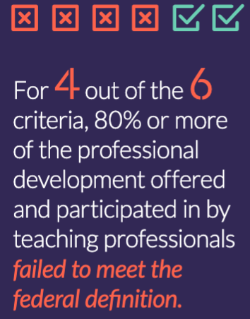

Every Student
Succeeds Act
(ESSA)

Slide 7
How has professional learning changed in the last six months?

Slide 8
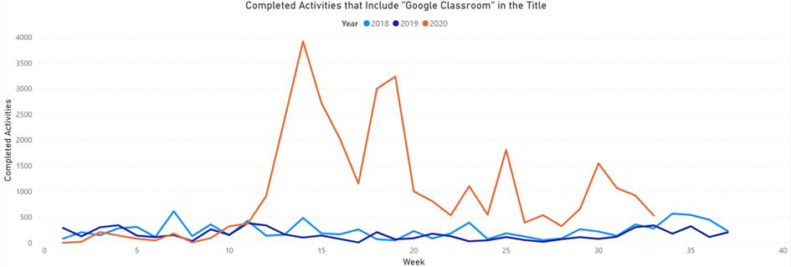
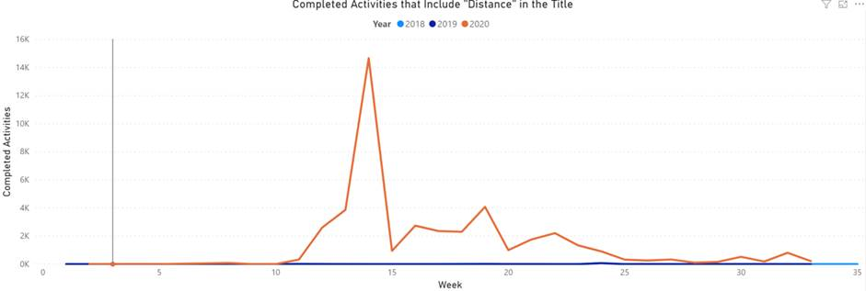

Slide 9
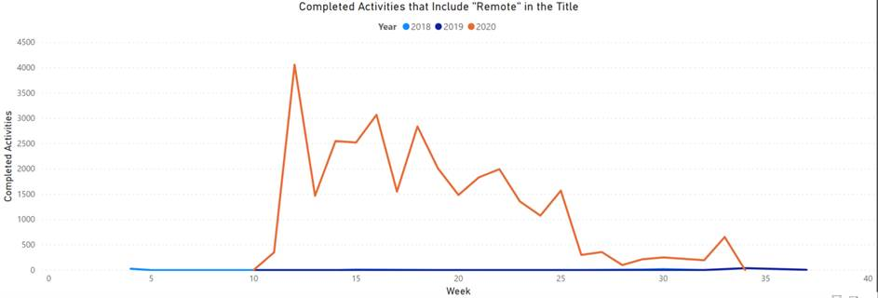
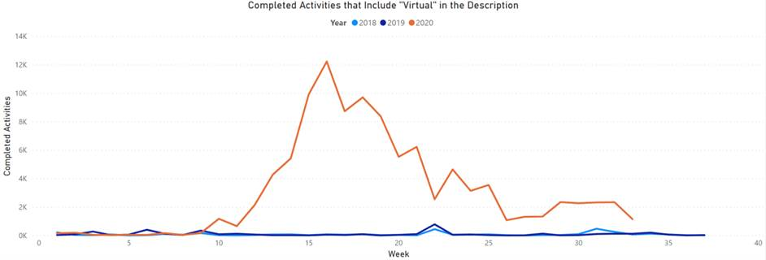

Slide 10
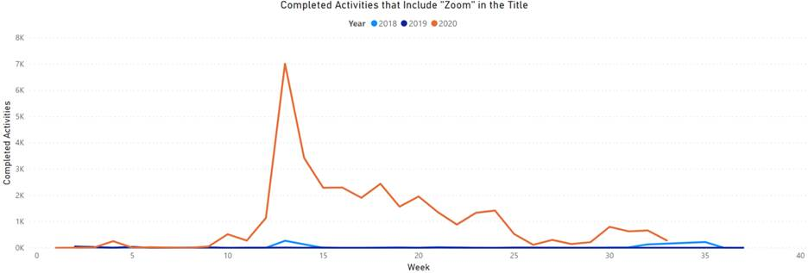

Slide 11
District Leader
Perspectives
Notes:
So much to consider when developing, managing, and implementing your New Teacher Induction Programs for Teachers and all of your employees! I am very fortunate to be able to hear from educators like yourself from all over the country. Earlier, you heard a little about Carnita Thomas! Today, I have the pleasure to facilitate a conversation and get her valuable insights on what she is doing in Harmony, Texas!

Slide 12
Engaging Teachers and Staff with Online Learning Options
FEATURING
April Strong
Instructional Coach
Martin County School District Florida

Slide 13
Further Learning & Reflection
How do you keep best practices of professional learning a focus in your district?
Analyze the tools and resources you must utilize to ensure they meet your changing needs.
Consider the ‘change factor’ when implementing and supporting online learning programs.
How do you ensure employees are growing professionally, making an impact on students, and are fulfilled in their role at your district?
Notes:
Frontline Resources In Chat…

